Slide 1
Low Beta Algorithm trading
Group: yu wang, Yan yu, Qiaodan Zuo

Slide 2
content
Beta-Neutral 101
Why Beta-Neutral
Algorithm Comparison
Detail Of Beta-Neutral Algorithm
Risk Measures Of Beta-Neutral Algorithm
Conclusion

Slide 3
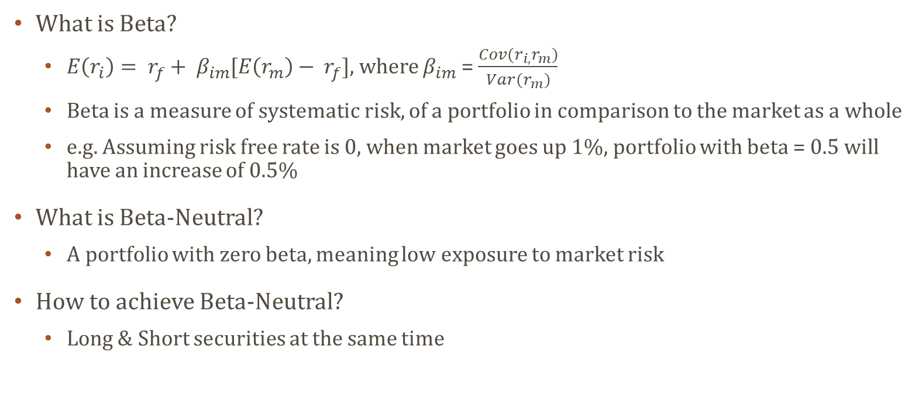
Beta neutral 101
What is Beta?
$E\left(r_{i}\right)= r_{f}+ β_{im}[E\left(r_{m}\right)− r_{f}]$, where $β_{im}$ = $\frac{Cov(r_{i,}r_{m})}{Var(r_{m})}$
Beta is a measure of systematic risk, of a portfolio in comparison to the market as a whole
e.g. Assuming risk free rate is 0, when market goes up 1%, portfolio with beta = 0.5 will have an increase of 0.5%
What is Beta-Neutral?
A portfolio with zero beta, meaning low exposure to market risk
How to achieve Beta-Neutral?
Long & Short securities at the same time

Slide 4
Why beta-neutral
Why is Beta-Neutral Strategy useful?
A major way to avoid market risk
Stable performance even during crashes, avoid survivorship bias
Lower systematic risk with well diversified portfolio
Who would like Beta-Neutral Strategy?
Universities
Pension Funds
Family Offices
Hospitals
Sovereign Wealth Funds
etc.

Slide 5
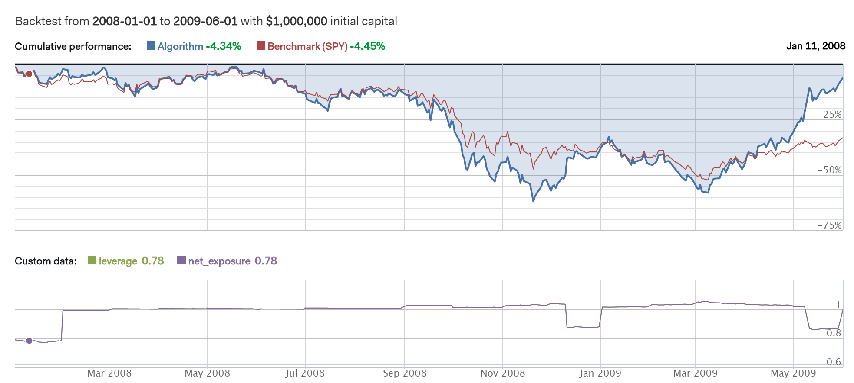
Non Beta-Neutral (long only)

Slide 6
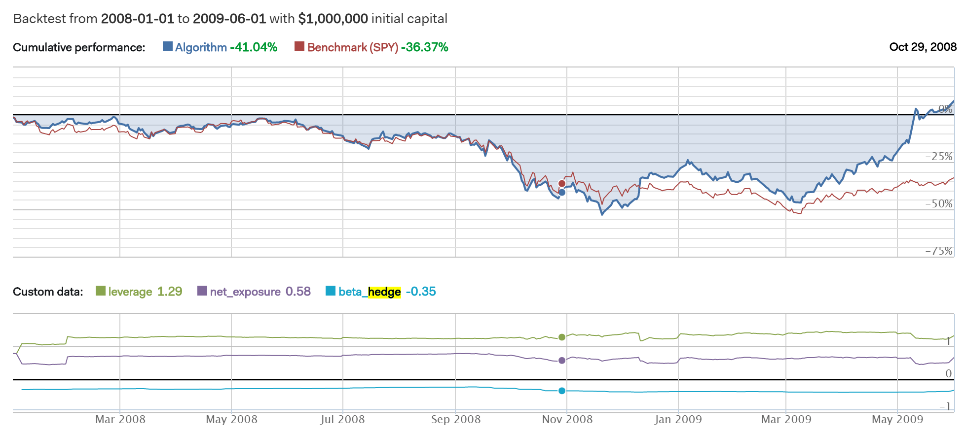
Non Beta-Neutral (Beta-hedge)

Slide 7
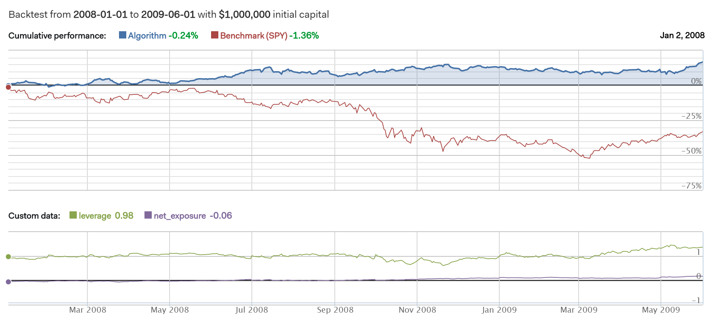
Beta-Neutral

Slide 8
Risk measure comparison

Slide 9
Detail of Beta-neutral Algorithm
Quantopian
Leading back testing platform using Python 2.x
Assumptions
Transactions fee: $0.0075/Share, $1/Order
Benchmark: SPDR S&P 500 ETF Trust (SPY)
Slippage: 0.025 volume limit, 0.1 price impact
Momentum
Bull stocks or bear stocks usually have momentum due to the late react of investors
Buy winners and sell losers
Pair Trading
Long & short pairs of security
Theoretically profitable in all market situation, leads to market neutral
Notes:
VolumeShareSlippage(volume_limit=0.025, price_impact=0.1)
You can take up to 2.5% of a minute's trade volume
For the 10-share order, the price impact is .1 * (10/1000) * (10/1000), or .001%.
The slippage is calculated by multiplying the price impact constant by the square of the ratio of the order to the total volume.

Slide 10
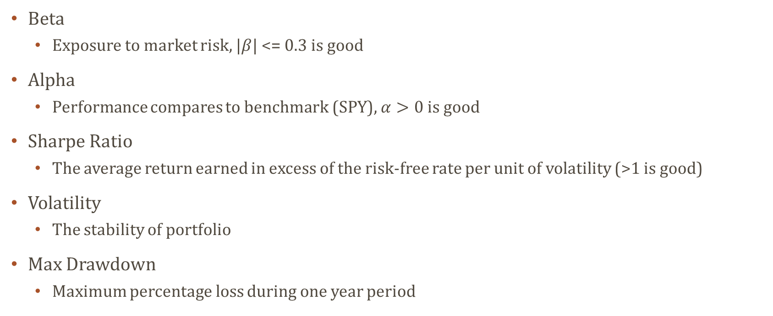
Risk Measures of Beta-neutral algorithm
Beta
Exposure to market risk, $|β$| <= 0.3 is good
Alpha
Performance compares to benchmark (SPY), $α>0 is good$
Sharpe Ratio
The average return earned in excess of the risk-free rate per unit of volatility (>1 is good)
Volatility
The stability of portfolio
Max Drawdown
Maximum percentage loss during one year period

Slide 11
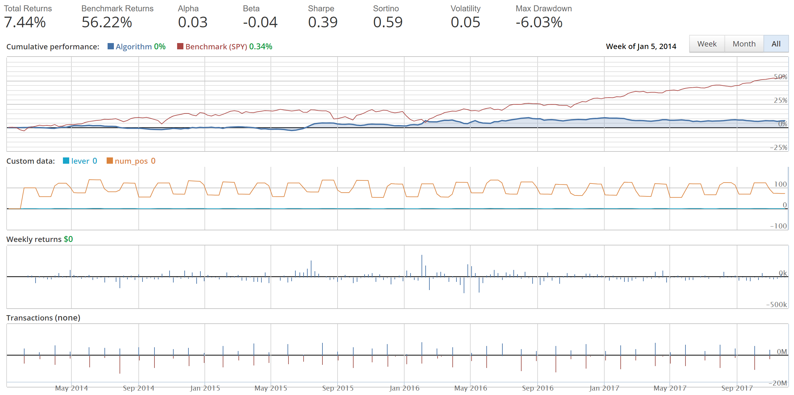
Recent 3 years

Slide 12
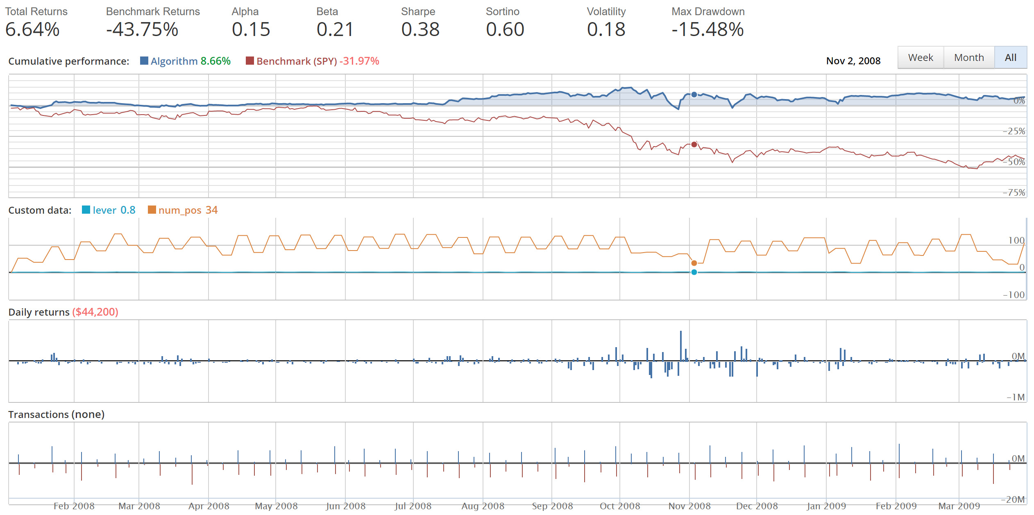
2008 Financial crisis

Slide 13
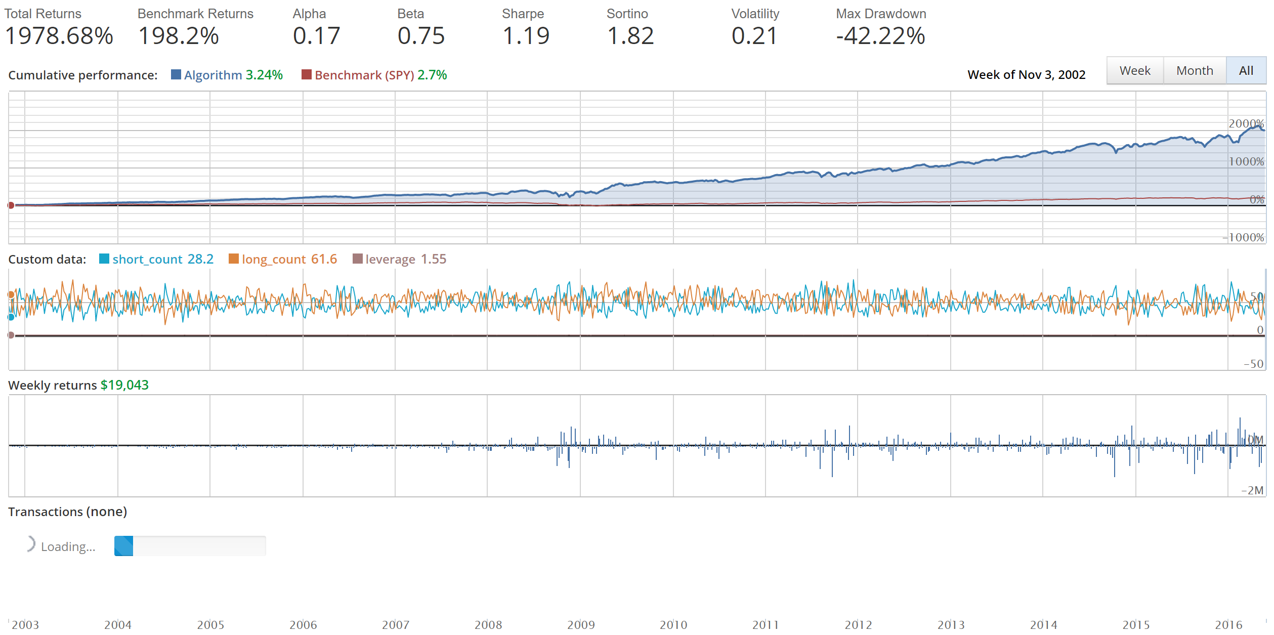
Who cares beta!

Slide 14
Conclusion
Market-neutral funds designed to provide returns that are unrelated to those of the overall stock market
Reduce systematic risk – use for diversification of portfolios
Requires dynamic adjustments – High transaction fees
Focus on stability and risk aversion rather than extraordinary return

Slide 15
references
Backtesting Bias and How we avoid it, https://keepingstock.net/backtesting-bias-and-how-we-avoid-it-fe598930cb1
9 Mistakes Quants Make that Cause Backtests to Lie, https://blog.quantopian.com/9-mistakes-quants-make-that-cause-backtests-to-lie-by-tucker-balch-ph-d/
Quantopian Allocation, https://www.quantopian.com/allocation
The Art Of Not Following the Market, https://www.quantopian.com/posts/quantopian-lecture-series-the-art-of-not-following-the-market
Investopedia, https://www.investopedia.com/
Lecture Notes

Slide 16
Questions

Slide 17
Thank you

